Slide 1
CANDIICE.COM
See our website for more resources
WHAT KIND OF DEMOCRACY ARE WE TEACHING?
Adam Newman Turner CANDIICE Coordinator
antmail44@gmail.com

Slide 2
If people are not born democrats, then education surely has a significant role to play in ensuring that democrats are made
Cook and Westheimer (2006)

Slide 3
A B
Notes:
For full details of this exercise go to https://candiice.com/learning-activities/ and look for “Speed Debates and U Turns”
To warm up the group, start with a quick debate activity.
Get people into pairs and tell them they will have some very short debates in their pairs. Ask them to decide which of them is ‘A’ and which ‘B’. The topic of each debate will be called out by the facilitator who will also tell everyone which side of the debate they are arguing. For example “If you are ‘A’ you are in favour of the statement, if you are ‘B’ you are against.
Facilitator then tells them when to start and when to stop (about 2 minutes for each debate)
After the debate, ask the As to change partners to a different B person. The same debate can be repeated.
After a couple of debates announce that everyone has changed to the opposite side of the argument – i.e. they now argue the exact opposite to the side they defended first. This allows them to remember and use what they have just heard from their opponents – so they will have some ideas.
After a few changes of partner, move on to a different topic and repeat the process.
This is good exercise for thinking quickly and understanding different points of view.

Slide 4
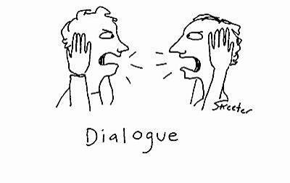
A – B ‘Speed debating’
Like a lawyer defending a criminal in court…
You may not really believe it… but you must argue your point

Slide 5
Flying is frying the earth
We should ban all air flights (except emergencies)

Slide 6
All people over the age of 15 years should be able to vote in local and national elections

Slide 7
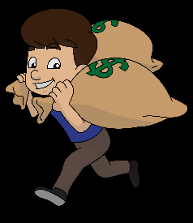
Measuring Education Success or Failure?
The best way to measure how good a school or university is
To measure the average earnings of all graduates when they reach the age of thirty.

Slide 8
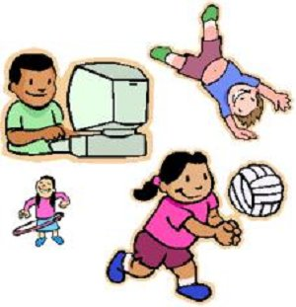
Technology is bad for youth
Parents should restrict young people’s use of internet, smartphones and computer games to 1 hour per day after school or college (under age 18)

Slide 9
Democracy ?
Effective education for democracy leaves learners able to…
Write 2 – 3 words
Notes:
Ask everyone to consider what should be learned during education to produce a democratic citizen who will defend future democratic rights.
We all care…. Right? But do we all resist authoritarian assaults on democracy?
Did his education make him a guardian of democracy?
Did yours?
Contested word
The fairest way of deciding?
Governing by the will of the majority?
How things are decided in free countries?
Watch your social media…. Then vote…

Slide 10
Effective education for democracy produces learners able to…
Follow an argument
See both sides of an issue
Understand why some people disagree with you
Learn from others’ viewpoints
Give reasons for your opinion
Disagree without aggression

Slide 11
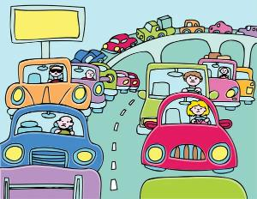
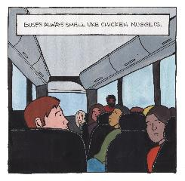
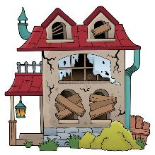
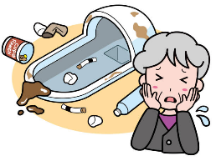
On your journey here today…
Something you SAW… that you would like to
CHANGE / IMPROVE / MAKE DIFFERENT
SSSHHH !! No words .. Only quick drawing

Slide 12
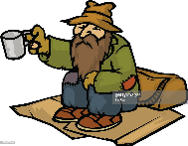
Guess from picture only

Slide 13
Effective education for democracy produces learners able to…
Look and reflect on their own environment
Increase shared vocabularies of description (verbal, visual, auditory, emotional, imaginative…)
Develop critical analyses
Compare and share perceptions with others
Collaborate over visions for improvement
Notes:
Vocabularies of description: Democracy of the five senses – we might analyse and describe with a perspective of age, infancy, disability, non-native language readers… etc
Democracy incomplete if it excludes some life experiences

Slide 14
Learning activities…
List some knowledge a 12-year old should know about democracy
Key skills needed to sustain / improve future democratic culture
School experiences which give experience of living democratically
Notes:
This can be done individually or in pairs. Then reported back to the group.

Slide 15
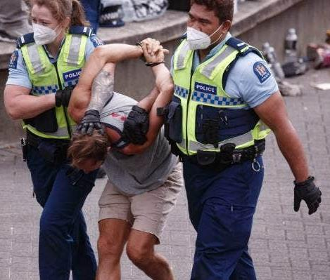
“Don’t it always seem to go,
You don’t know what you’ve got…
‘Til it’s gone…”
Joni Mitchell
‘Big Yellow Taxi’
Ladies of the Canyon 1970
Notes:
Discuss whether the group think that some legitimate democratic freedoms are already being curtailed.
Why is this be so? What reasons can a governing party give for reducing democratic rights and freedoms?
What freedom should people have to protest about government policies? Freedom of speech?
What law changes and restrictions weaken inclusive democratic rights?

Slide 16
Missiles and Balloons

Slide 17
Notes:
This starts a discussion exercise to decide which features support or harm inclusive democracy.
Think of democracy as a floating airship. We all want it to remain floating healthily in the air.

Slide 18
Notes:
Sometimes things change and democracy is weakened or attacked. These things are causing holes in the airship and risking collapse.

Slide 19
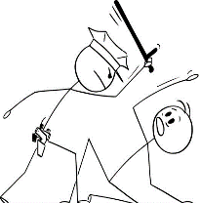
Notes:
If inclusive democracy is badly weakened and authoritarian control takes over, bad things can happen for most people, while a few people get rich and need police protection.

Slide 20
O
C
R
A
E
M
D
Y
Notes:
Some things can support healthy democracy – these are shown as balloons to help hold up the airship

Slide 21
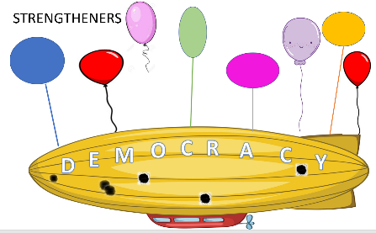
The Supreme Court judges responsible for the national constitution are personally appointed and dismissed by the president | The national constitution cannot be changed unless there is a 70% majority in a national referendum
The president can change the date of the presidential elections by up to three years in case there is a national emergency | Information about government spending is classified as security information and not available for the public to see
The symbolic head of state is the Monarch. The oldest male child of the royal family inherits the job when the Monarch dies | “Citizenship, media and community education” is a well-funded core subject that all will study until age 18
It is a human right, protected by law, to meet in groups, speak publicly and hold public demonstrations that (may disrupt traffic) as long as there is no violence | All donations given to political parties must be declared and published and there is a limit of 500 Euros from any one person
National election campaigns are limited to two weeks | You must show a valid national ID card before you can vote in elections
A new law is introduced that newspapers must publish news stories every day which improve national wellbeing by making people feel positive about the country and its president | There is no limit to the amount of money that a political candidate can spend on TV, newspaper and social media advertising
Only people whose parents were born in the country are allowed to vote in elections | The national education curriculum is defined by an independent committee of education experts
Newspapers are free to publish any stories as long as they are supported by evidence | Nearly all newspapers and TV channels are owned by extremely rich men
Which of these
are BALLOONS…
and which are
MISSILES?
You decide
Notes:
In this activity each small group is given some printed slips of card or paper with these statements printed on them. You could make up some more to suit your local situation.
They must decide if each one is an ‘arrow’/’missile’ or a ‘balloon’

Slide 22
Effective education for democracy produces learners able to…
Build and work in diverse teams
Collaborate to arrive at decisions
Present a group proposal to a wider audience
Develop an advocacy campaign
Understand and use media communications

Slide 23
DEMOCRACY…
Isn’t automatic
Only works if everyone included
Can be weakened, damaged… is harder to restore
Requires citizens’ competences
Requires CREATIVE, CRITICAL THINKING
Collaborative creativity is a first step…
Notes:
Not the natural order of things
What if minorities are excluded or ignored?
“Don’t it always seem to go … you don’t know what you’ve got…..Joni Mitchell
Complex thing to relate to – motorbike

Slide 24
Effective education for democracy produces learners able to…
Empathise with others – of different backgrounds
Feel compassion for others’ needs
Create imaginative visions of the future
Value diversity
Value justice and inclusion

Slide 25
What does a democratic citizen need to learn?
Vocabulary – see, describe and evaluate what’s around you
Sharing / listening / observing / slow reflection
Identity – valuing self and others
Creativity / vision / what could be better?
Values / what is justice?
Democracy – compromise / consensus
Organisation skills
Confidence and compassion
How democracy can be destroyed
Notes:
Work in small groups to discuss how well are we including these essential elements in the school curriculum today?

Slide 26
Learning outcomes: What is ESSENTIAL LEARNING? Pick your top 5
Knowledge of voting system + government structure
Intelligent debate…listening
Local community work – ‘service learning’
Demonstrations / protest / activism / campaigning
Joining a political party
Donating money to charity
Joining social media campaigns, Tik Tok, Twitter…etc.
Media literacy / recognise bias and propaganda
Always vote in elections
Add one of your own ideas…>???

Slide 27
Are we teaching for ‘Thick’ or ‘Thin’ democracy?
‘THIN’ democracy = Voting / Elected Leaders / Individual ‘Freedoms’
‘THICK’ democracy = Critical Engagement / Collective Participation
Political Literacy / Inclusion / Justice Orientation
Gandin & Apple (2002)

Slide 28
A ‘WHOLE-SCHOOL’ APPROACH What is a school for democratic citizenship?
Curriculum for democratic competences (see Council of Europe)
Student councils
Whole-school participation / consultation event – ‘The School Forum’
Student groups collaborate with other schools – Conferencing
Activities involving learners in school/community improvement

Slide 30
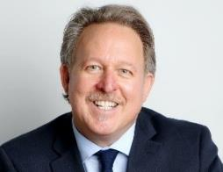
Carr, P et al. 2018. Final Report of the Research Project DEMOCRACY, POLITICAL LITERACY AND TRANSFORMATIVE EDUCATION. University of Quebec, Canada

Slide 31
Carr, P. et al.
Carr, P et al. 2018. Final Report of the Research Project DEMOCRACY, POLITICAL LITERACY AND TRANSFORMATIVE EDUCATION. University of Quebec, Canada

Slide 32
Thank you! Please go to WWW.CANDIICE.COM For much more information

